Slide 1
Clustering
Amal Joseph
Machine Learning Engineer @ Arcesium

Slide 2
Overview
Introduction to Clustering
Clustering Examples
Understanding K-Means Clustering
Hands-on

Slide 3
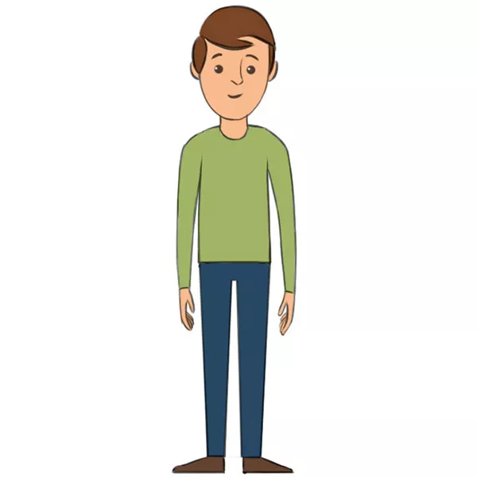

Slide 4


Slide 5


Slide 6
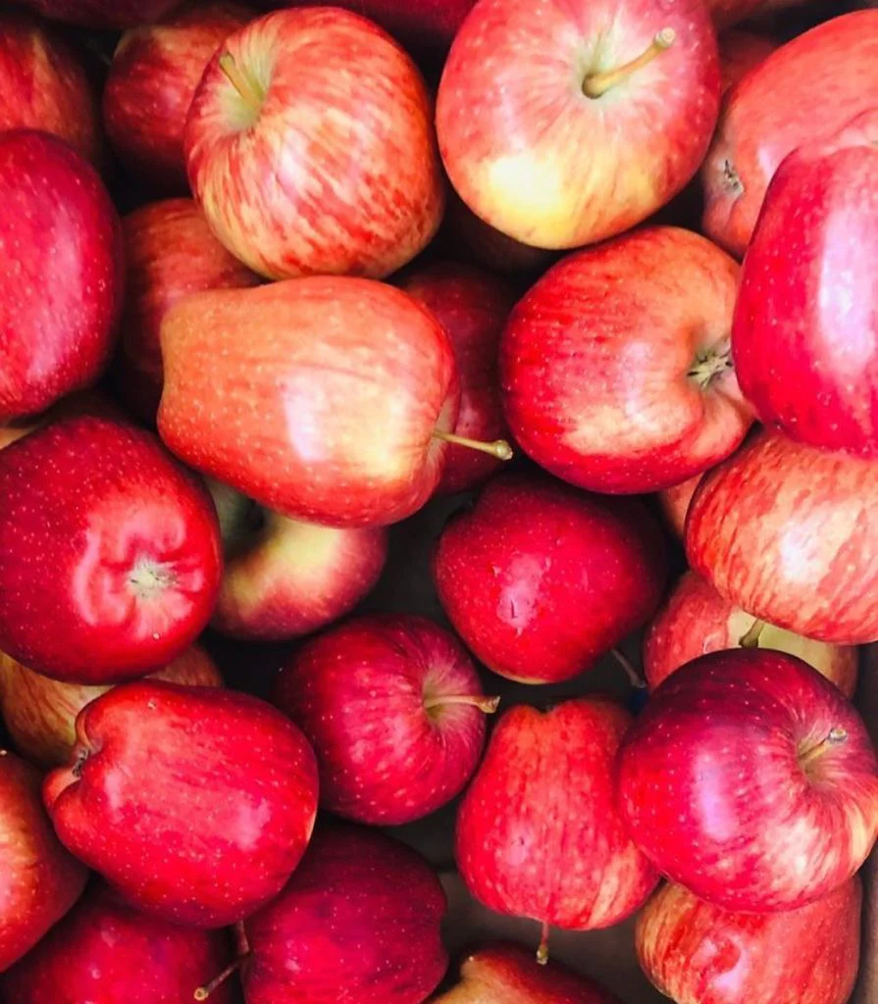

Slide 7
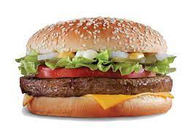

Slide 8
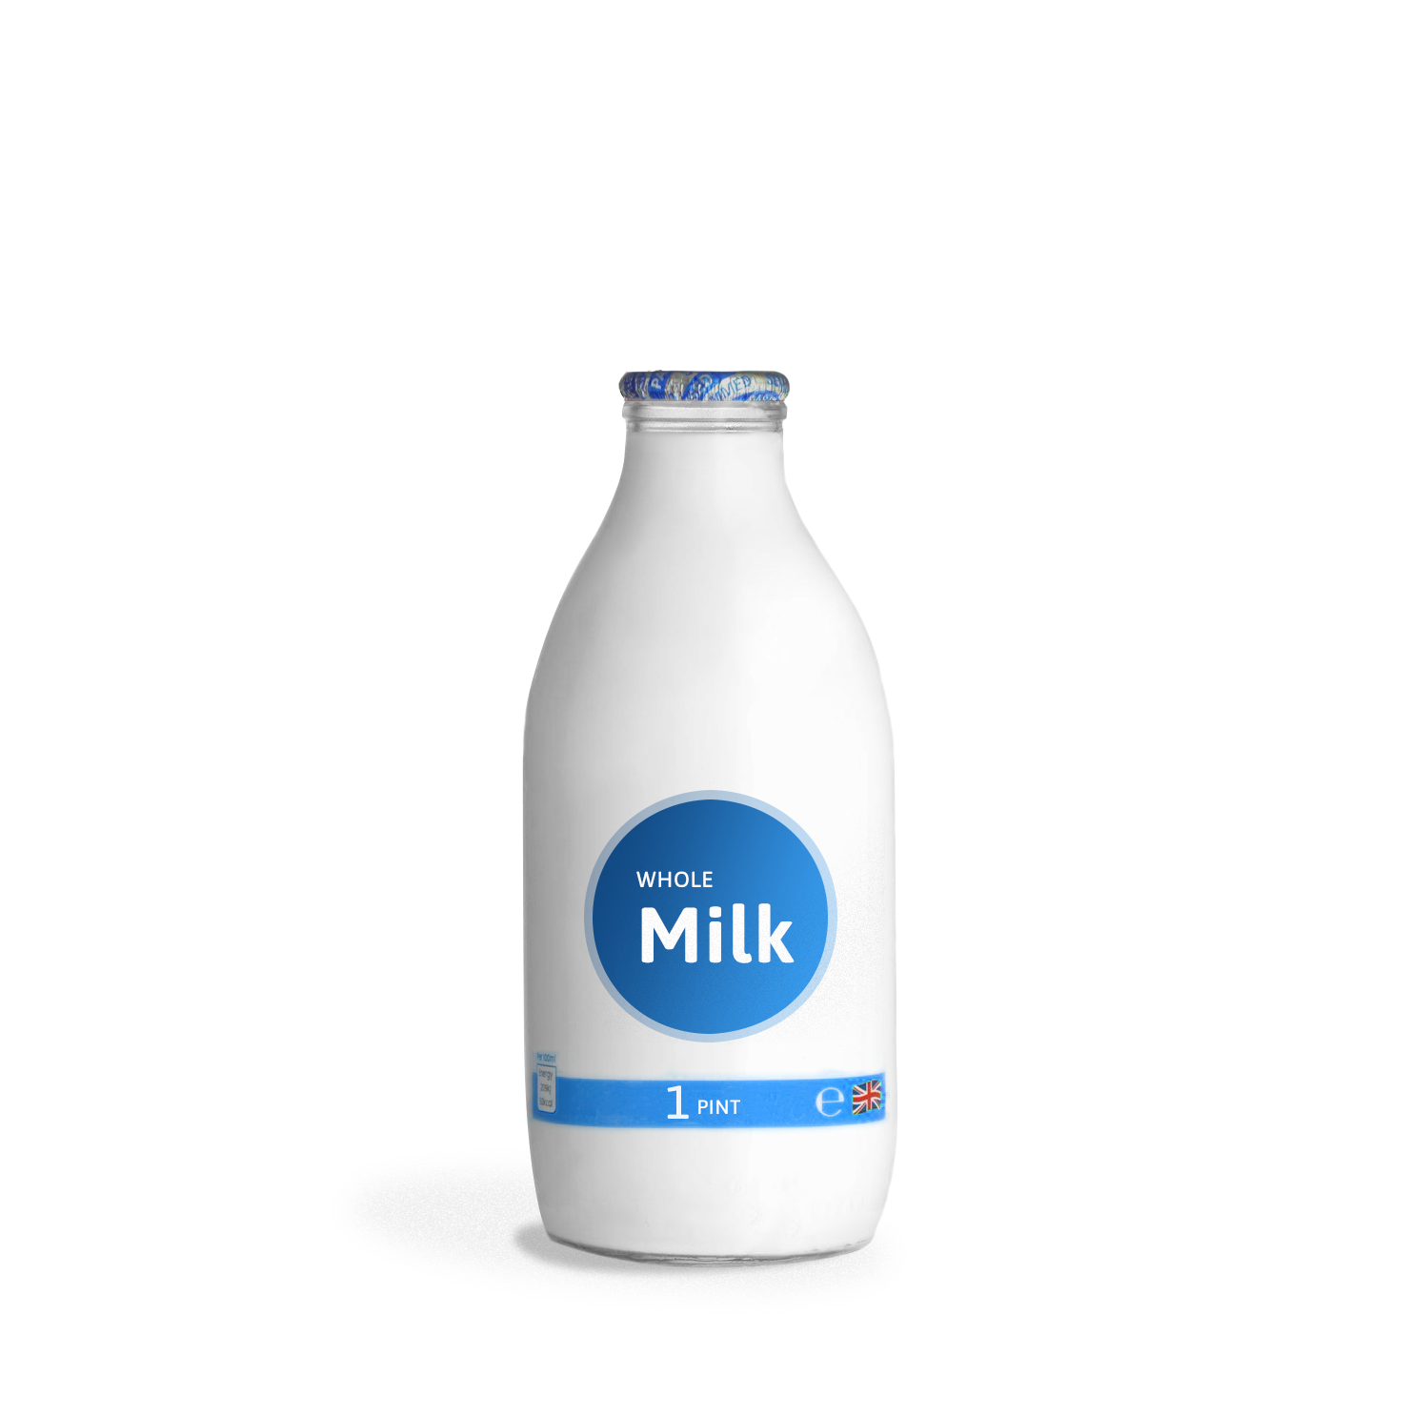
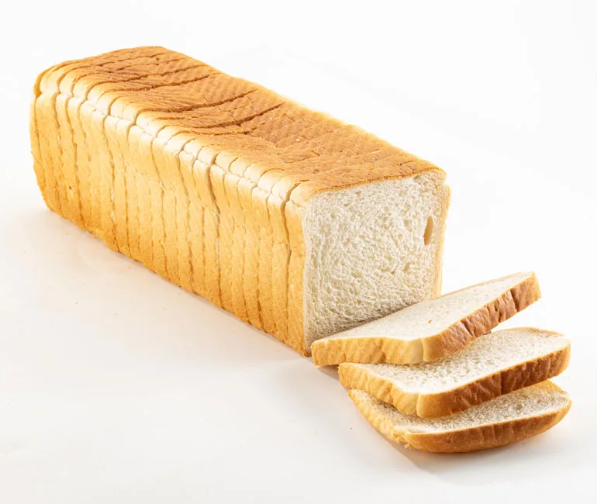
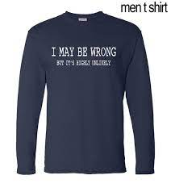
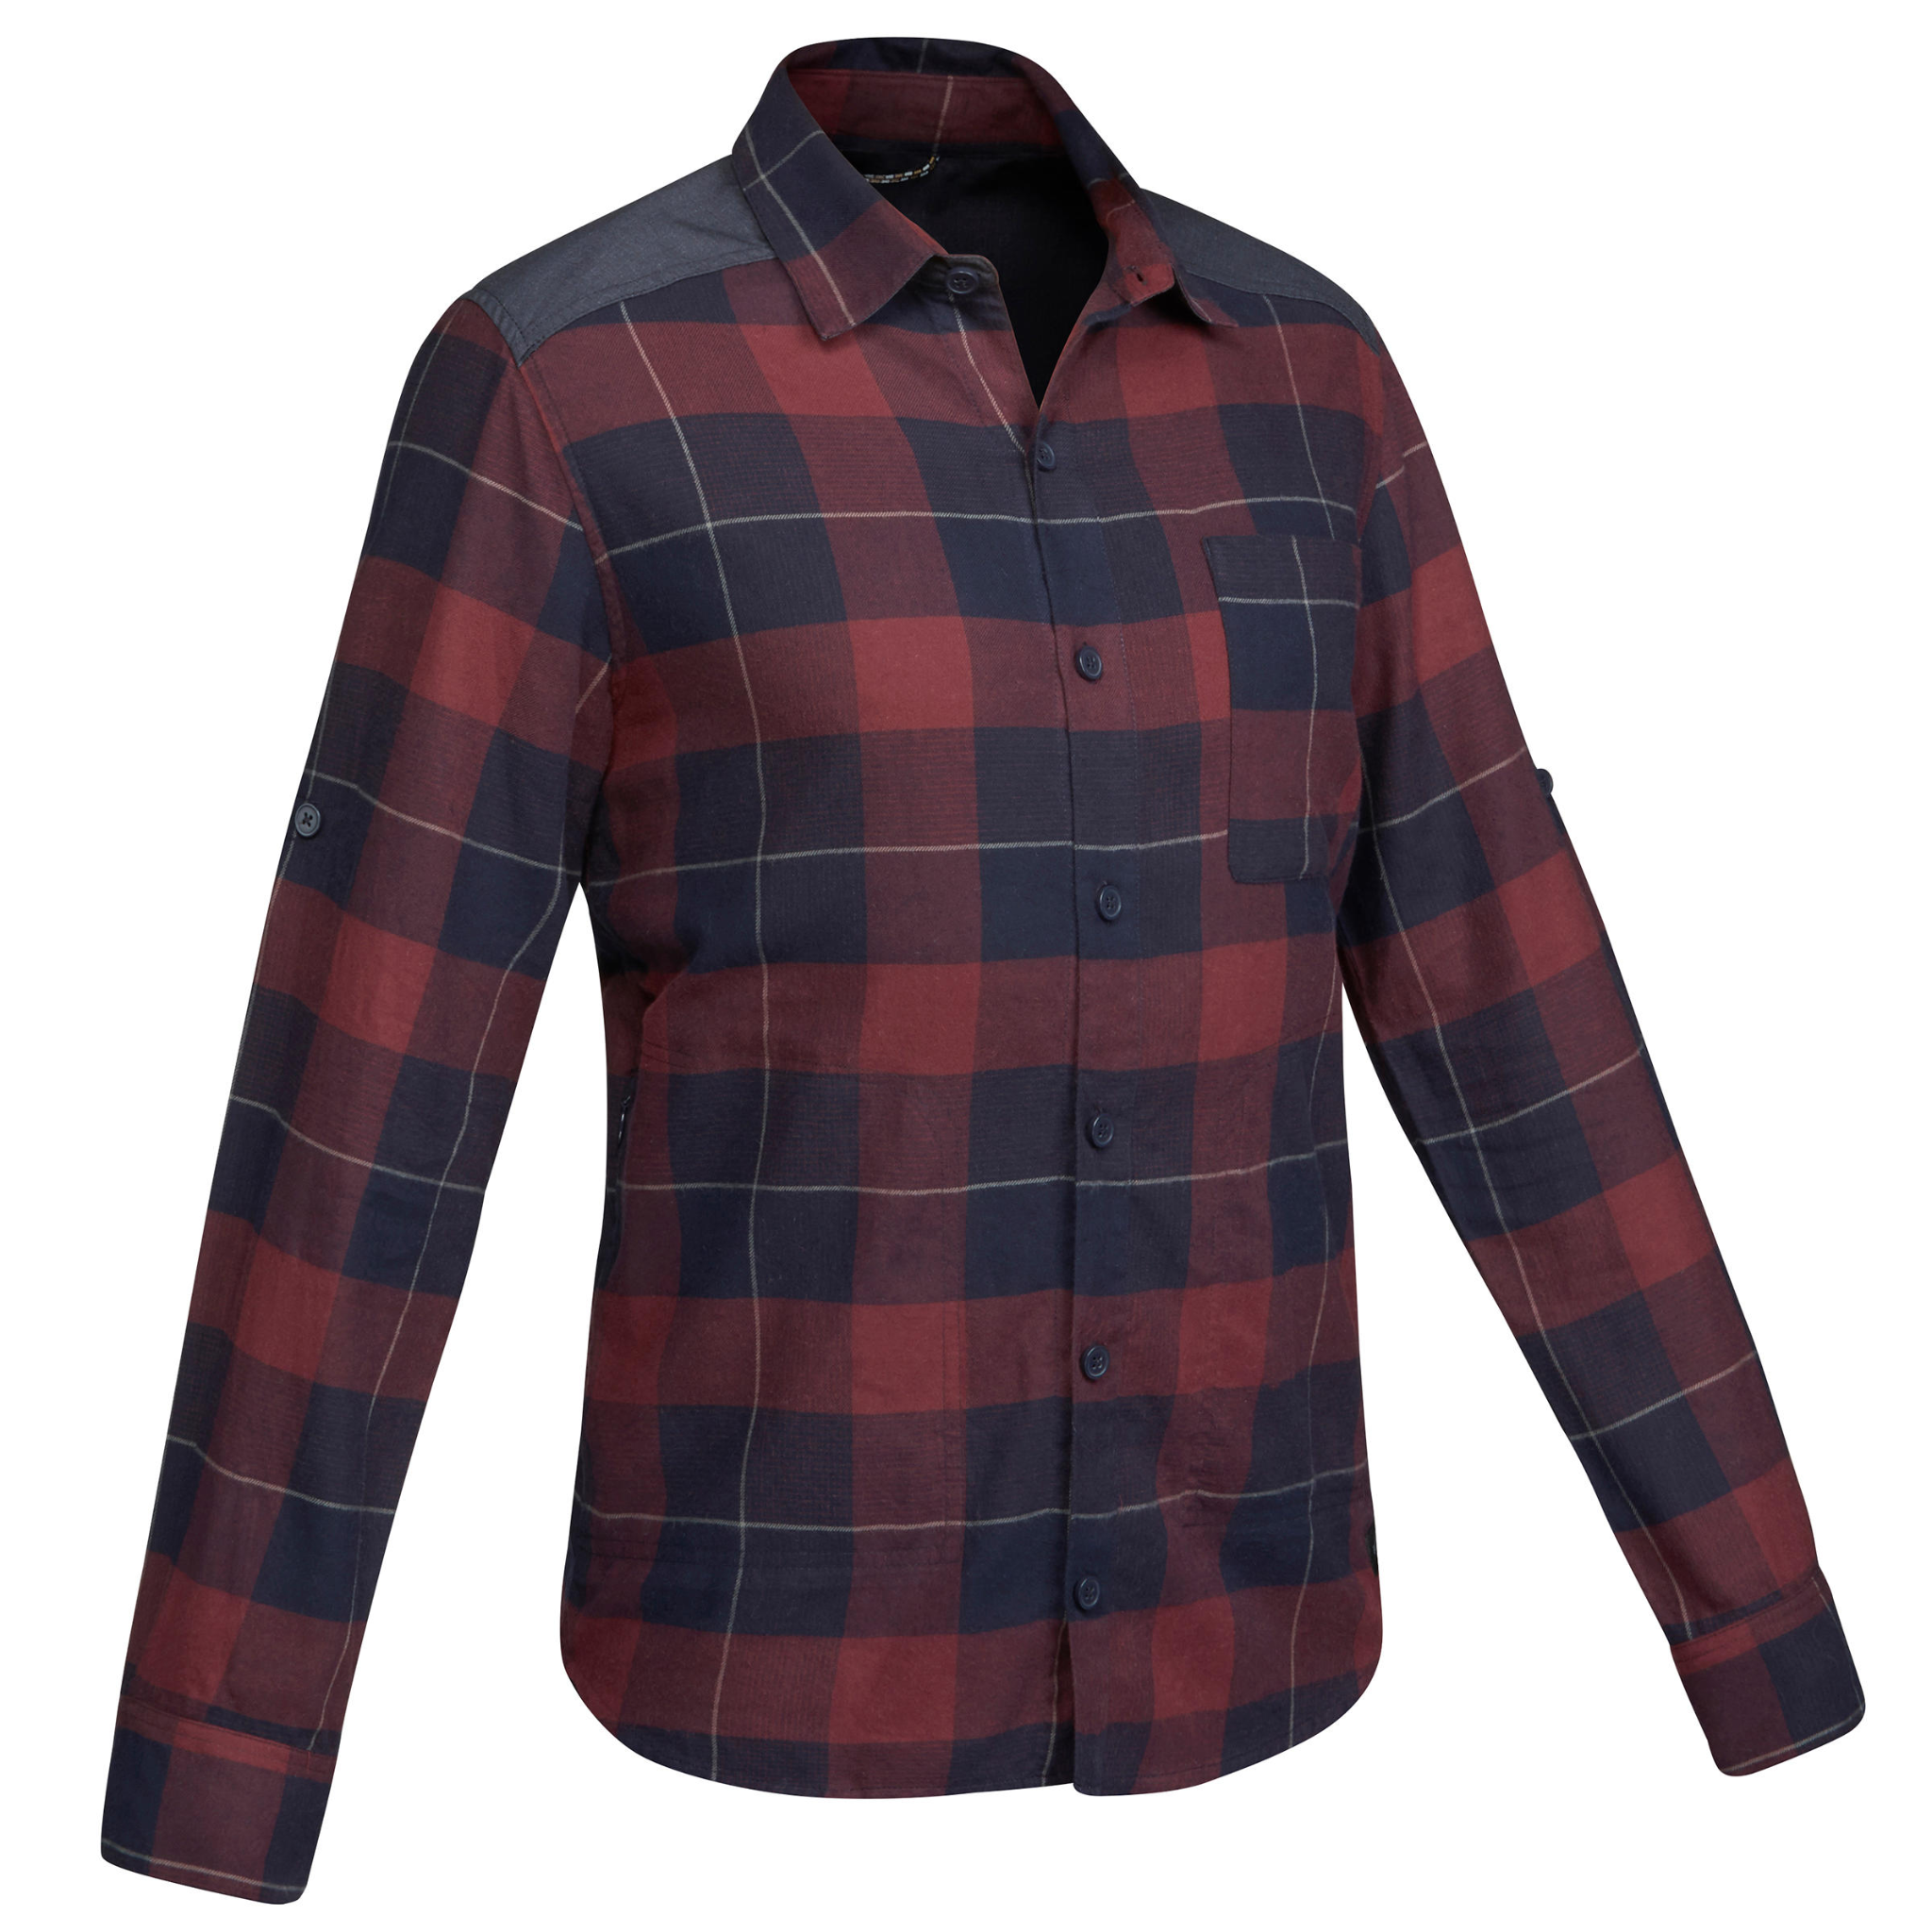
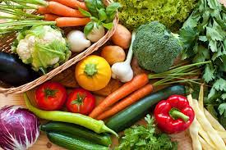

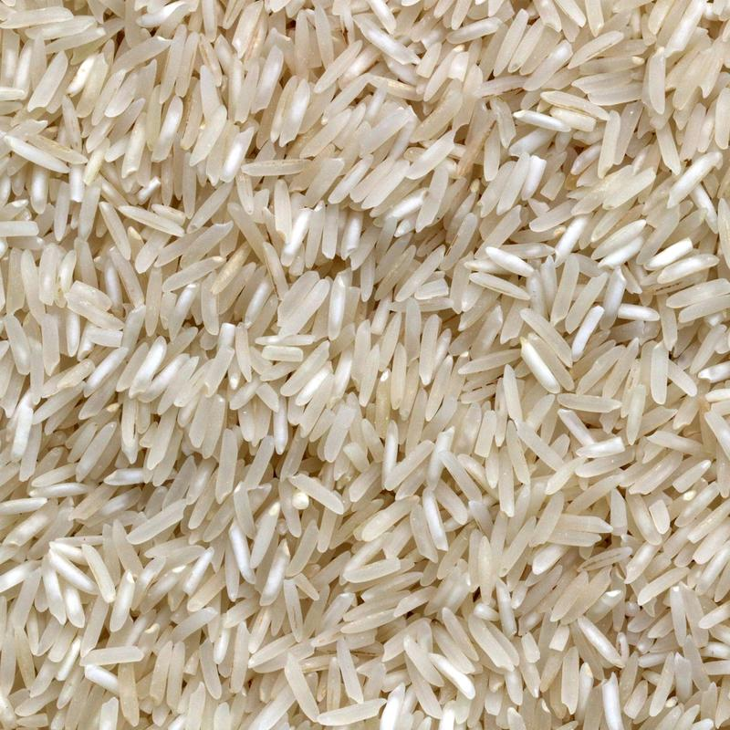



Slide 9
How can we group these together?

Slide 10
Based on types of items!
Electronics

Slide 11
Based on types of items!
Food
Electronics

Slide 12
Based on types of items!
Electronics
Food

Slide 13
Based on types of items!
Cloths
Electronics
Food

Slide 14
Is this the right cluster?

Slide 15
Is this the right cluster?
Are more clusters possible?

Slide 16
Is this the right cluster?
Inexpensive
Expensive

Slide 17
Is this the right cluster?
More clusters might be possible.
It maynot be evident for us now.

Slide 18
Is this the right cluster?
More clusters might be possible.
It maynot be evident for us now.
Here we could use ML to figure out underlying clusters

Slide 19
Clustering
Cluster analysis, or clustering, is an unsupervised machine learning task.
It involves automatically discovering natural grouping in data.
Unlike supervised learning (like predictive modeling), clustering algorithms only interpret the input data and find natural groups or clusters in feature space.

Slide 20

Clustering Examples
Retail Marketing - Clustering customer group (high spenders/ low spenders)
Email Clusters

Slide 21
Clustering Examples
Retail Marketing - Clustering customer group (high spenders/ low spenders)
Email Clusters
Movie Streaming - Netflix can group similar movies and suggest them to users.
Health and wellness - Clustering patients to understand who needs immediate care.

Slide 22
K-Means Clustering
K-Means Clustering is an Unsupervised Learning algorithm, which groups the unlabeled dataset into different clusters.
Here K defines the number of predefined clusters that need to be created in the process, as if K=2, there will be two clusters, and for K=3, there will be three clusters, and so on.

Slide 23
K-Means Clustering
It is a centroid-based algorithm, where each cluster is associated with a centroid.
The main aim of this algorithm is to minimize the sum of distances between the data point and their corresponding clusters.
The algorithm takes the unlabeled dataset as input, divides the dataset into k-number of clusters, and repeats the process until it does not find the best clusters. The value of k should be predetermined in this algorithm.

Slide 24
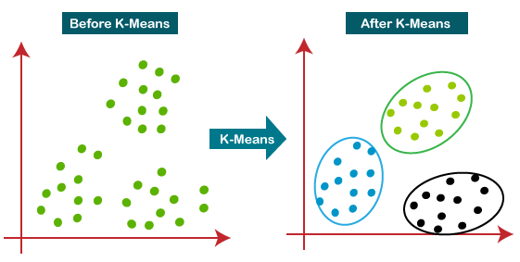

Slide 25
K-Means in Action !!

Slide 26
K-Means in Action !!
Step 1 - Decide k, the number of clusters

Slide 27
K-Means in Action !!
Step 1 - Decide k, the number of clusters
K = 2
(2 clusters)

Slide 28
K-Means in Action !!
Step 2 - Select k random points from the data as centroids
K = 2
(2 clusters)

Slide 29
K-Means in Action !!
Step 3 - Assign all the points to the closest cluster centroid
K = 2
(2 clusters)

Slide 30
K-Means in Action !!
Step 3 - Assign all the points to the closest cluster centroid
K = 2
(2 clusters)

Slide 31
K-Means in Action !!
Step 3 - Assign all the points to the closest cluster centroid
K = 2
(2 clusters)

Slide 32
K-Means in Action !!
Step 4 - Recompute the centroids of newly formed clusters
K = 2
(2 clusters)

Slide 33
K-Means in Action !!
Step 5 - Repeat steps 3 and 4
K = 2
(2 clusters)

Slide 34
K-Means in Action !!
Step 5 - Repeat steps 3 and 4
K = 2
(2 clusters)

Slide 35
Stopping Criteria for K-Means Clustering
There are essentially three stopping criteria that can be adopted to stop the K-means algorithm:
Centroids of newly formed clusters do not change
Points remain in the same cluster
Maximum number of iterations is reached

Slide 36
Time for Hands On
Download dataset from bit.ly/day8_dataset
Get Colab notebook from bit.ly/day8_notebook

Slide 37
Please give your feedback
bit.ly/day8_feedback

Slide 38

Connect with us on Instagram
instagram.com/tbh.ind

Slide 39
Please give your feedback
bit.ly/day7_feedback

